Slide 1
STANCE DETECTION IN TWEETS
NLP GIANTS:
Bharath Chandra Reddy(M12510331)
Rachit Aggarwal(M12506500)
Kowshik Bhowmik(M10584257)
Krishna Sai Patnana(M12483628)

Slide 2
What is Stance Detection?
Stance detection is the process of detecting the stance of the person on a particular subject/target.
We are going to detect from a person’s tweet if he/she is in favor or against a given target entity.

Slide 3
Example
Target: ​legalization of abortion
Tweet: ​ A foetus has rights too! Make your voice heard.
Stance: Against

Slide 4
Task Description
Sub-task A: Supervised Framework
Atheism
Climate Change is a Real Concern
Feminist Movement
Hillary Clinton
Legalization of Abortion
(~3000 Labeled Tweets combined for All Targets)
Sub-task B: Un-Supervised Framework
Donald Trump
(~70,000 unlabeled tweets )

Slide 5
Approach
Sub-Task-A | Sub-Task-B
Pre-processing
Feature Selection & Extraction
Classification | Clustering

Slide 6
Pre-Processing
This stage involves :
Separation of Hashtags,
Elimination of punctuations
Conversion of slangs and abbreviations into their correct forms from the training corpus
Lowercasing
Removal of URL’s and “Not Available” tweets(Sub-task B)

Slide 7
Feature Selection
Bi-Grams
Noun Phrases
Hashtags
Sentiment scores

Slide 8
Feature Extraction
Bi-Grams
Extracted only the most frequent Bigrams
Discarded the Stop word Bigrams
Tf-idf vectorization for Bigrams
Noun Phrases
Tokenization-
POS Tagging-
Parsing
Count Vectorization

Slide 9
Feature Extraction
Hashtags
Re- Introduced Hashtags in this phase
Used only the most frequent Hashtags
Count Vectorization
Sentiment scores
Calculated using AFFIN Dictionary
Normalized the scores

Slide 10
Classification
.
Subtask-A:
Supervised Learning
Used Gaussian Naïve Bayes
Subtask-B:
Unsupervised Learning
Used k-Means Clustering

Slide 11
Results
Sub Task A:
Achieved Improvement ~ (18% on an avg. for all targets)
Avg. Accuracy:
Proposal performance: 37.5 % accurate
Final performance: 55.7 % accurate

Slide 12
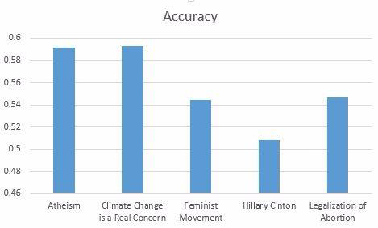
Accuracy Performance measure Task-A

Slide 13
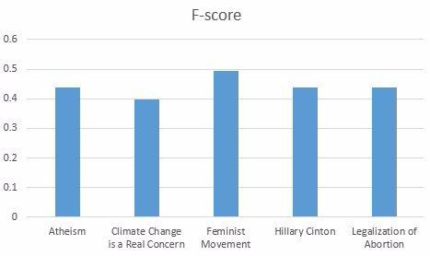
F-score Performance measure Task-A

Slide 14
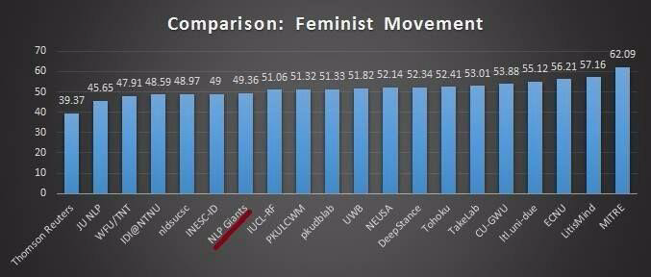
Subtask A: Feminist Movement
We achieved an F-score of 49% on this task.
We stood 14th among the 20 teams which have performed this task.

Slide 15
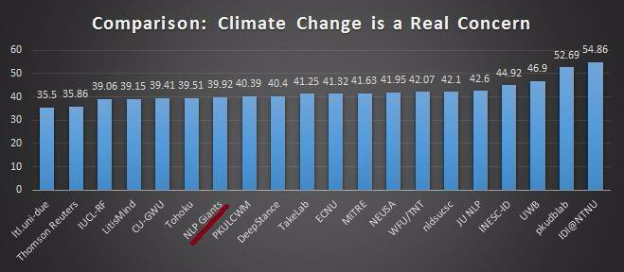
Subtask A: Climate Change is a Real Concern
We achieved an F-score of 40% on this task.
We stood 14th among the 20 teams which performed the task.

Slide 16
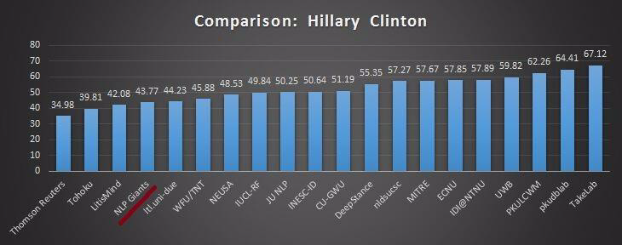
Subtask A: Hillary Clinton
We achieved an F-score of 43.7% on this task.
We stood 17th among the 20 teams which performed the task.

Slide 17
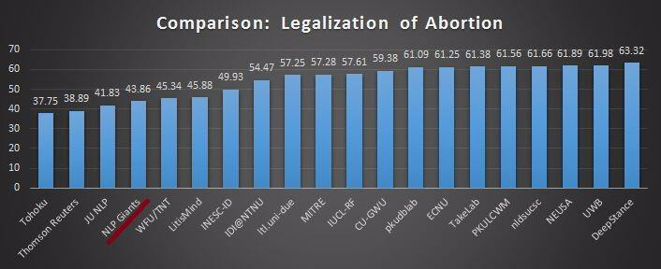
Subtask A: Legalization of Abortion
We achieved an F-score of 44% on this task.
We stood 17th among the 20 teams which performed the task.

Slide 18
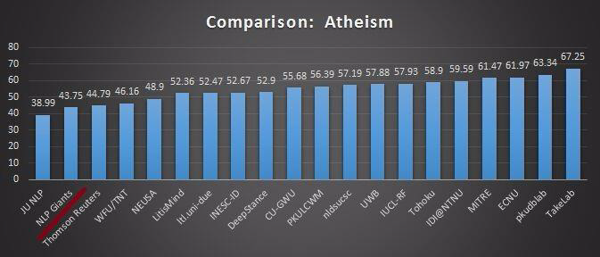
Subtask A: Atheism
We achieved an F-score of 43% on this task.
We stood 19th among the 20 teams which performed the task.

Slide 19
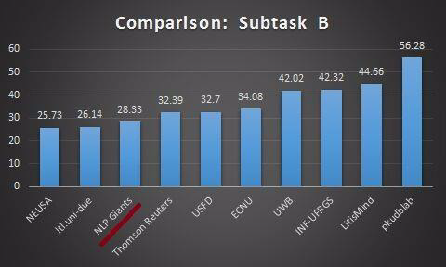
Task B: Donald Trump
We achieved an F-score of 28% on this task.
We stood 8th among the 20 teams which performed the task.

Slide 20
Discussion
Differences between our Proposal and Final Performances
Pre processing:
Performed lowercasing of tweets from the data
Additional Features:
Added Noun Phrases,
Sentiment Scores
Hashtags as features

Slide 21
Discussion (contd.)
Classification for Subtask A:
Proposal – Multinomial Naïve Bayes
Final – Gaussian Naïve Bayes
Discrete values Vs Continuous values
Classification for Subtask B:
No results for our proposal

Slide 22
Work Distribution
Rachit Aggarwal | Reviewed research papers Performed preprocessing on data which includes seperation of hashtags, elimination of punctuations and conversion of slangs Implemented K-means Clustering algorithm on Task-b. Worked on the report and the Powerpoint
Kowshik Bhowmik | Reviewed research papers Performed feauture selection and classfication which includes incorporation of Bi-grams, hashtags,sentiment features and classifier. Worked and implemented Guassian Naïve Bayes Classifier. Worked on the report and the Powerpoint

Slide 23
Work Distribution(Contd.)
Bharath Chandra | Reviewed research papers Performed preprocessing on Task-B which involves removal of URL’s, unnecessary punctuations and “Not Available Tweets Implemented the report and Powerpoint
Krishna Sai | Reviewed research papers Performed feature extraction for Noun phrases and worked on different classifiers Removed Tweet id’s of “Not Available tweets. Implemented the report and Powerpoint

Slide 24
THANK YOU

